Slide 1
Machine Learning in Research of Eyes
Prepared by: Kossov Assylbek

Slide 2
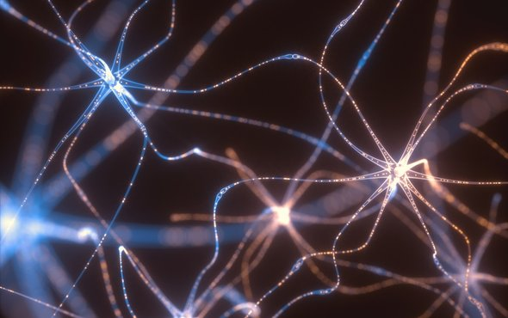
How to Predict Whether a Persons Eyes are Open or Closed Using Brain Waves

Slide 3
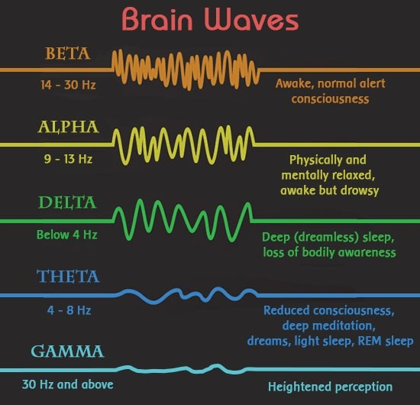
Types of waves

Slide 4
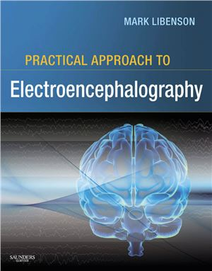
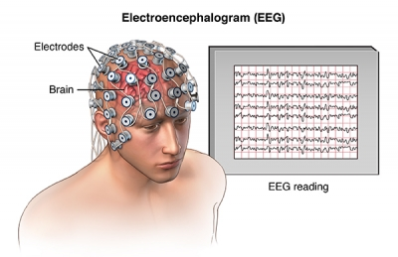
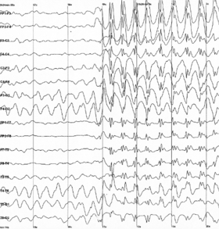

Slide 5
Thank you !!!
IT’S TIME FOR QA

